Slide 1
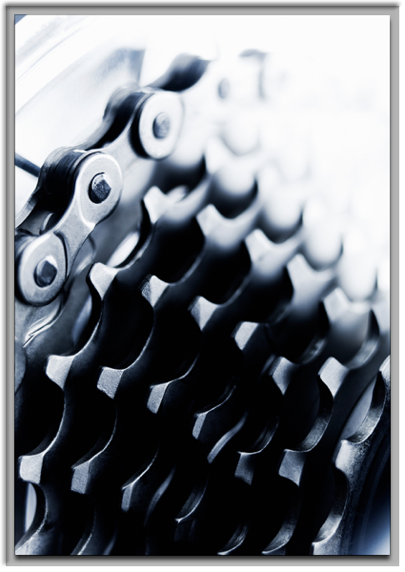
DRT
Kicking it up a gear

Slide 2
Motivations

Slide 3
Motivations
Algorithms
Architecture
Rate of change
Flexibility

Slide 4
Queues
Basic queues
NM1

Slide 5
NM1
Mean
Frequency
Processing times

Slide 6


How long?
A
E
D
C
B
Mean processing 60s

Slide 7
How long?
A
E
D
C
B
Mean processing 60s

Slide 8
How long?
D
E
C
Mean processing 60s

Slide 9


How long?
IS81
E
D
C
No visa

Slide 10
Multi-modal

Slide 11
Tail

Slide 12
Long tail
IS81/accompany minor etc

Slide 13
It was output only
You!
DRT recommender
Impossible! So. Now what?

Slide 14
Close the loop
You!
DRT recommender
Shifts
IS81
Meal breaks

Slide 15
Portfeeds
Http, email, ftp
Crunch
DB
Importer
API
Flight-stats
Rabbit
PAL
scala
PHP
You!

Slide 16
Fan in, fan out
STN
STN
Normalise, crunch
MAN
MAN
LHR
LHR

Slide 17
Change was difficult and slow
6 weeks to speed up an LHR crunch
A distributed monolith
Hard to test

Slide 18
Where are we going?

Slide 19
Http, email, ftp
DB
stats
Importer
Rabbit
L
scala
PHP
STN scala
MAN scala
You
EDI scala

Slide 20
Benefits
Reactive
1000x faster
"Closes the loop"
Responsive front end
Easier to test
Single technology front to back - reduces cognitive load
all of which means faster to change

Slide 21
Enables
As at views - no more screen shots
Close the next loop, find patterns closer to realtime

Slide 22
New!
Heat maps
IS81 button
Shifts
Totals columns
Auto allocation across queues (needs your input!)

Slide 23
Coming up
In no particular order
Passenger splits from advanced passenger info
Shifts durable storage
Flight change notifications
Forecast

Slide 24
LHR scala
LGW scala
STN scala
MAN scala
You
EDI scala

Slide 25
Building to your needs
Everything we've been building so far has been requested or inspired by users
Get involved!

Slide 26
Contact us
DRT hipchat channel.
Dev email address - drtdevteam@digital.homeoffice.gov.uk

Slide 27
Questions?

